Slide 1

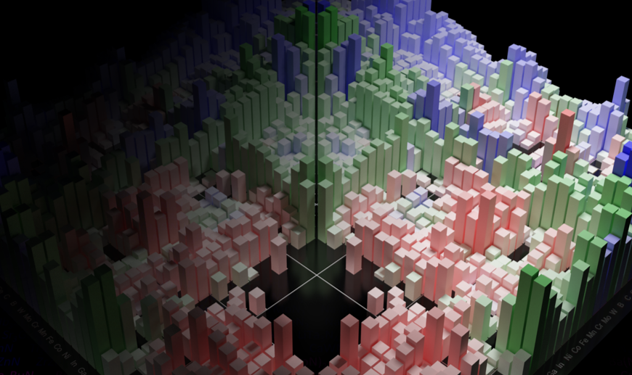
MSE 593 Data-Driven Materials Design and Genomics
Scientific Figures
The Good, The Bad, and The Ugly
Professor Wenhao Sun whsun@umich.edu
2023 Hokkaido Summer Institute
Notes:
Syllabus Wenhao Sun
Set up Canvas – Katsuyo
Google Survey – Katusyo

Slide 2
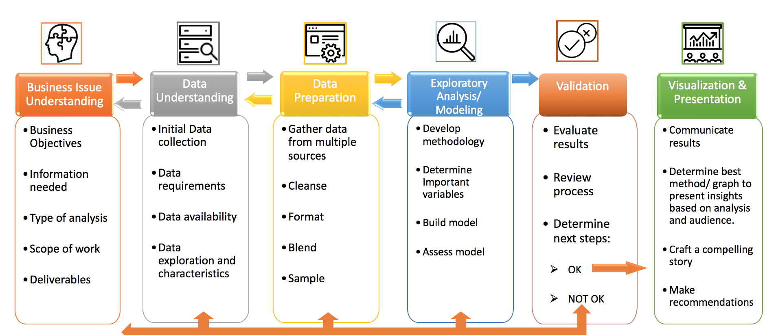
Cross-Industry Standard Process for Data Mining
(CRISP-DM)
Materials
Lecture 5-6

Slide 3

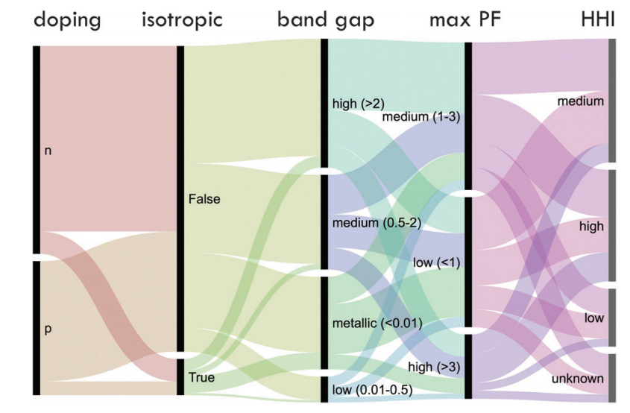
Fig. 1 Flow diagram representation of the data set of 48 770 compounds in this study. The term ‘‘doping’’ refers to the doping type that maximizes the power factor in our calculations. Compounds with power factors within 10% in all directions are considered ‘‘isotropic’’. The unit of band gap is eV and the unit of power factor is mW K2 m1 . HHI represents the Herfindahl–Hirschman Index of elemental reserves for the compound and is a measure of the resource criticality of the compound’s component elements, with ‘‘high’’ indicating that resources are geographically confined (undesirable) and ‘‘low’’ indicating geographically dispersed (desirable).

Slide 4
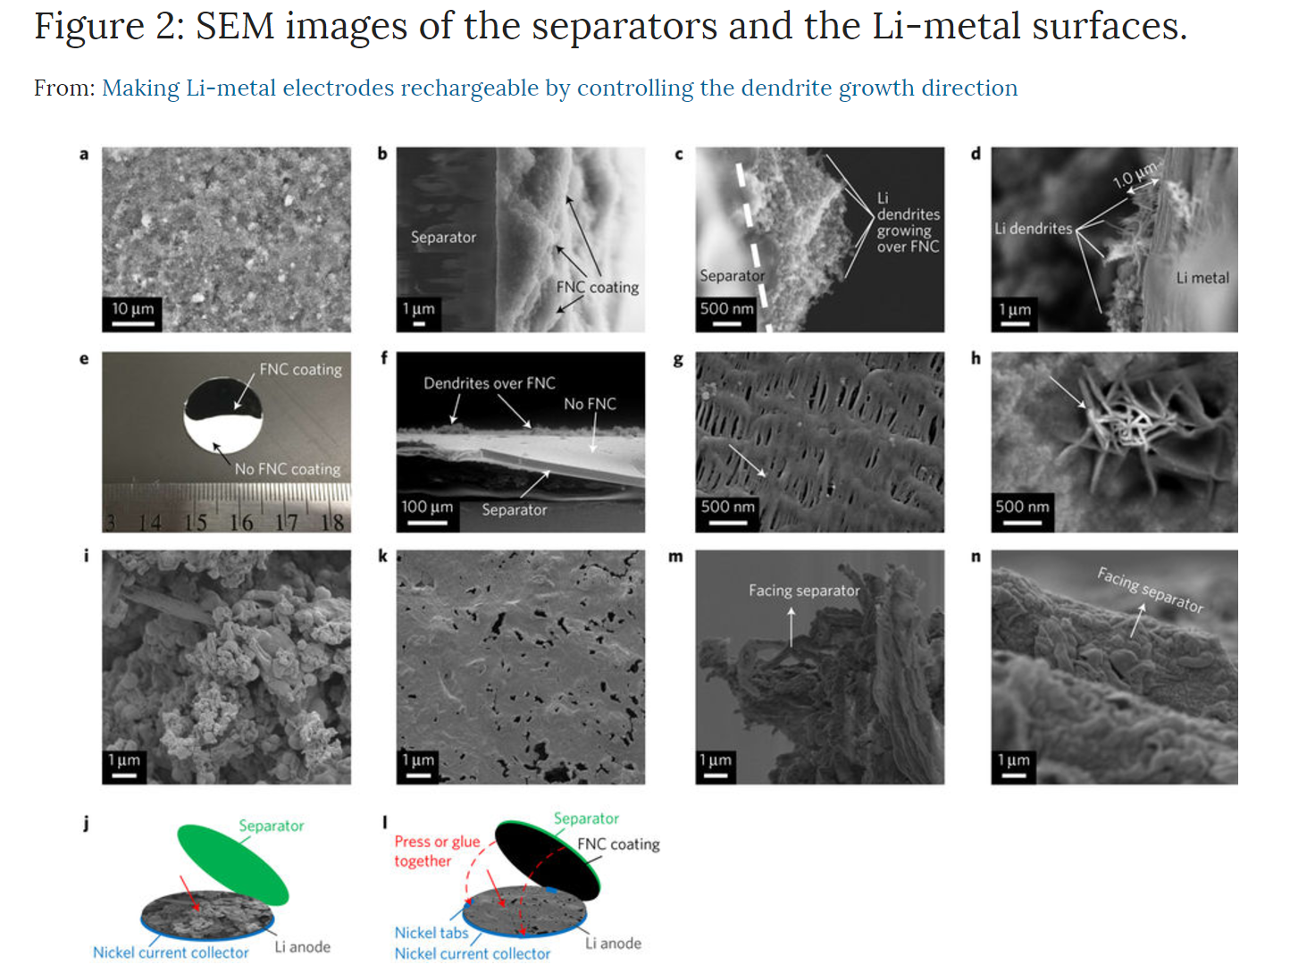
a,b, Top view (a) and cross-section (b) of the pristine FNC-coated layer. c, Cross-section of the FNC thin film coated on a separator. d, Cross-section of the Li-metal anode. (Both c and d are after 5 cycles and the Li dendrite can be seen clearly). e, A separator with a half-coated FNC thin film. f, The half-coated separator (after 5 cycles). g,h A top view of the backside of the FNC-coated separator (the arrow indicates a residual LiFePO₄ salt particle) (g) and the blank separator (the arrow points to the blade-shaped Li dendrite) (h). i, A top view of the Li-metal electrodes (facing the blank separator, after 500 cycles). j, The position where the image in i was taken (as indicated by the red solid arrow). k, A top view of the Li-metal electrode (facing the FNC-coated separator). l, The position where the image in k was taken (as indicated by the red solid arrow; dashed red arrows show how the nickel tabs and FNC coating layer were pressed or glued together). m, A side view of the cross-section of the Li-metal electrode (the arrow indicates the direction facing the blank separator). n, A side view of the cross-section of the Li-metal electrode (the arrow indicates the direction facing the FNC-coated separator). g–l are after 500 cycles in Li/LiFePO₄ CR2016 coin cells using a Celgard 3501 separator, 1.2 M LiPF₆ in EC/EMC (3:7), charge/discharge at a 1.0C rate (1.0 mA cm⁻²); area capacity 1.0 mAh cm⁻².
Nature Energy 2, 17083 (2017)
Notes:
keep

Slide 5
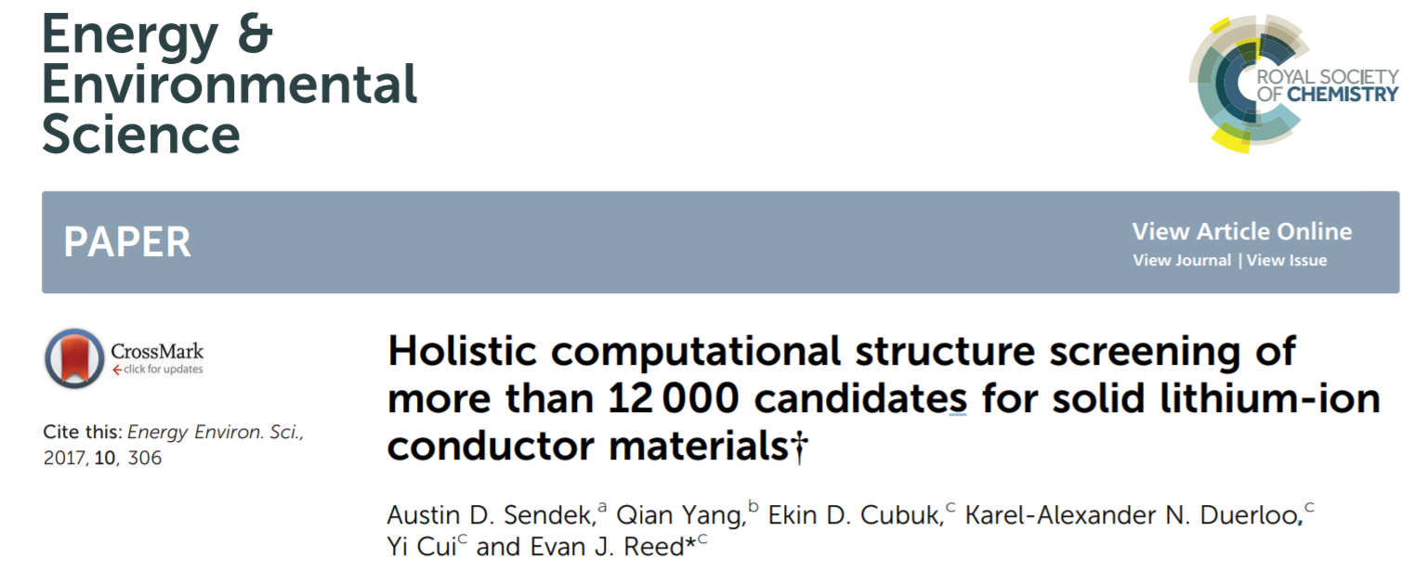
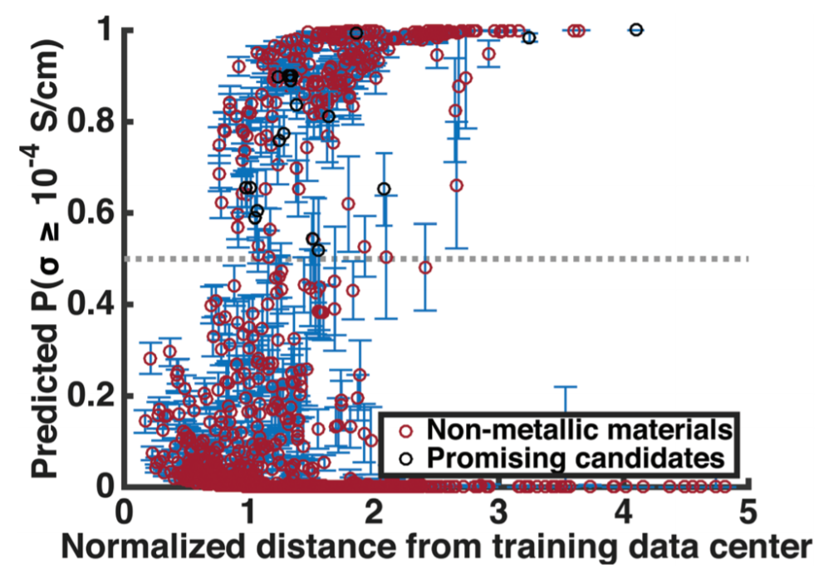
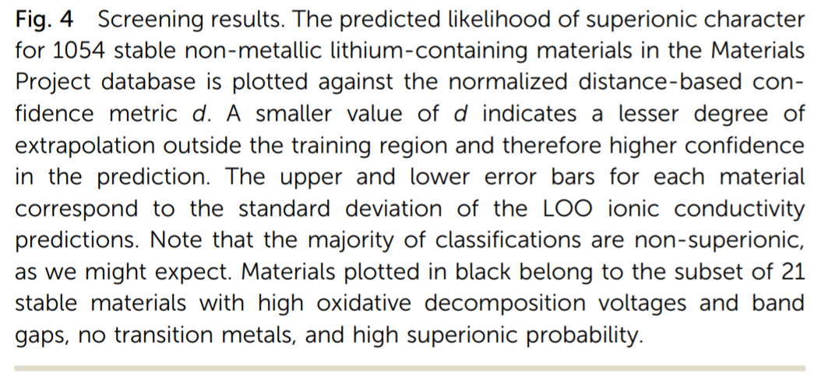

Slide 6
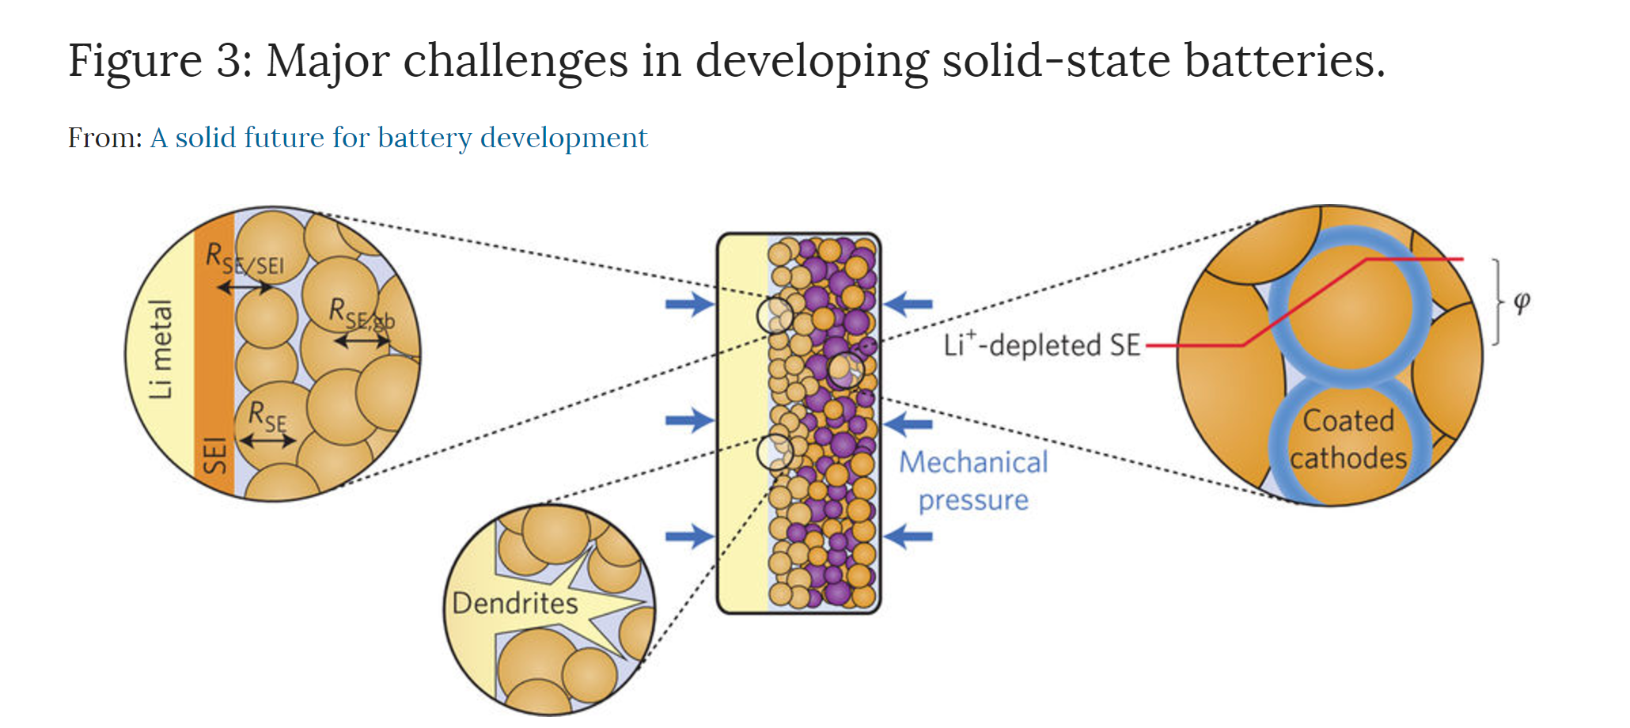
Nature Energy 1 (2016): 16141.

Slide 7
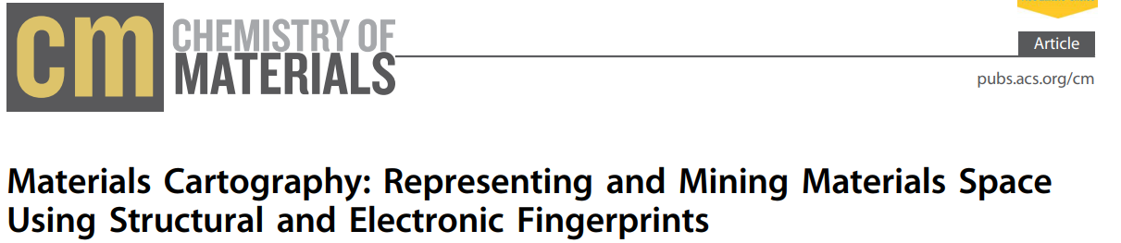
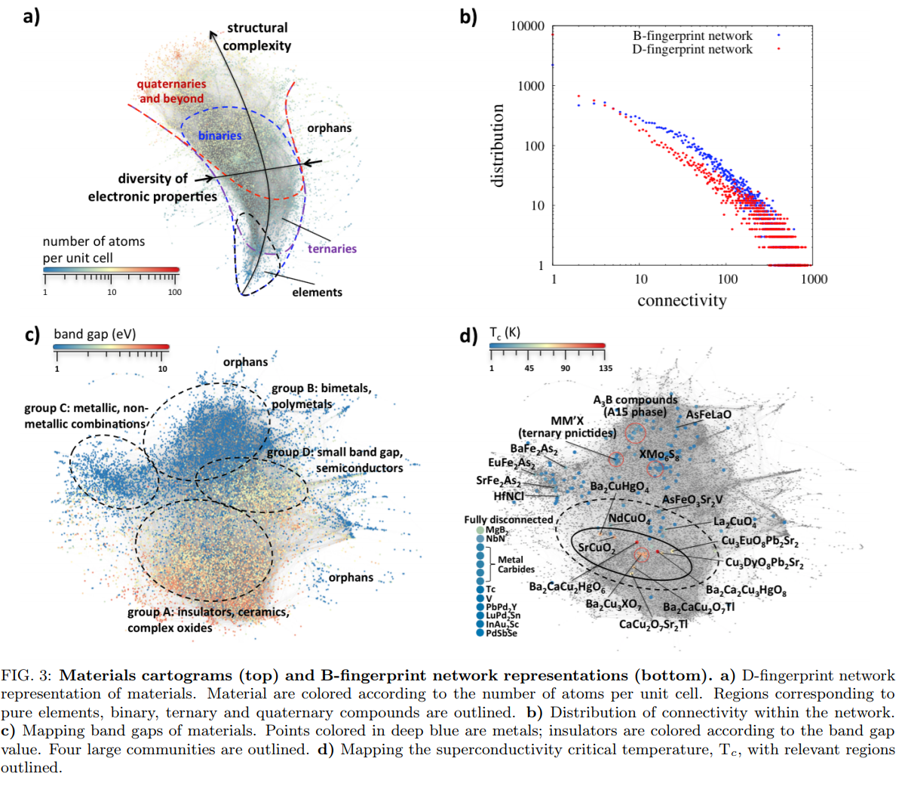
Materials cartograms with D- (top) and B-fingerprint network representations (bottom). (a) D-fingerprint network representation of materials. Materials are colored according to the number of atoms per unit cell. Regions corresponding to pure elements, binary, ternary, and quaternary compounds are outlined. (b) Distribution of connectivity within the network. (c) Mapping band gaps of materials. Points colored in deep blue are metals; insulators are colored according to the band gap value. Four large communities are outlined. (d) Mapping the superconductivity critical temperature, Tc, with relevant regions outlined

Slide 8
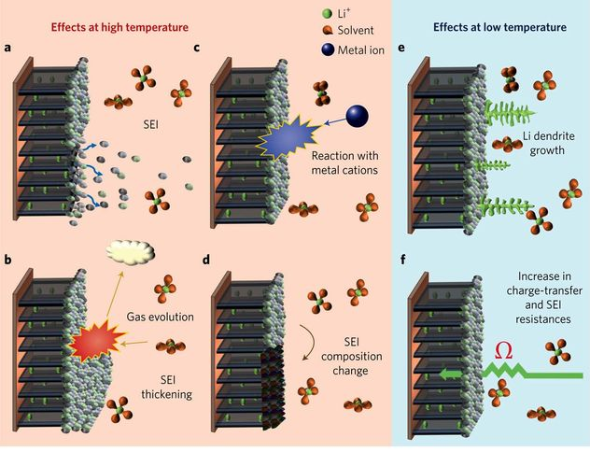
Figure 2: Challenges imposed by temperature on the performance of graphite anodes.
a–f, The many interfacial processes that might take place at the electrode. Elevated temperatures can damage the SEI (a), promoting further decomposition of the electrolyte to form a thicker and more resistive layer (b). The passivation film can also be negatively affected by reactive species generated on the cathode (c), which contributes to permanent changes in SEI composition (d). At the low temperature extreme, lithium plating becomes very problematic (e), and reaction kinetics are negatively affected by the increased R_{ct} and the SEI's blocking character.
Notes:
keep

Slide 9
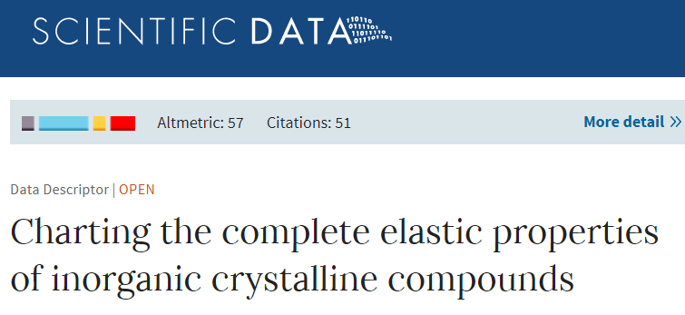
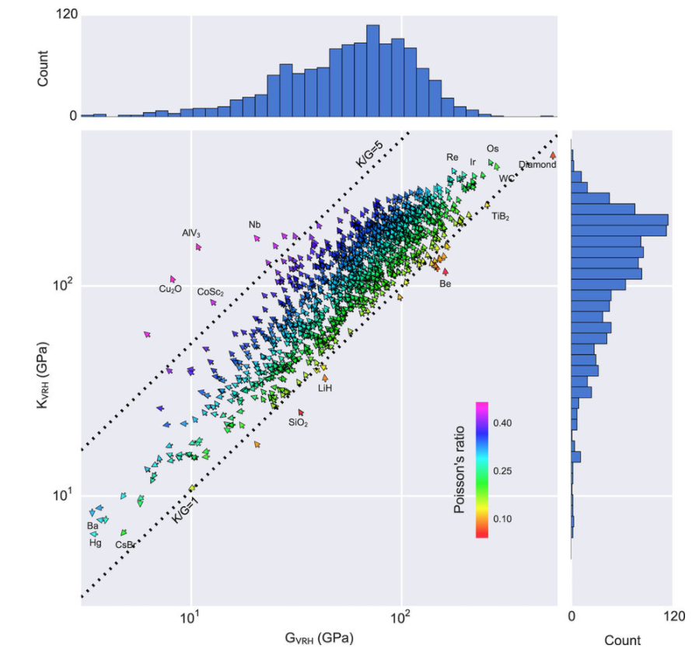
Figure 2. Distribution of calculated volume per atom, Poisson ratio, bulk modulus and shear modulus. Vector field-plot showing the distribution of the bulk and shear modulus, Poisson ratio and atomic volume for 1,181 metals, compounds and non-metals. Arrows pointing at 12 o’clock correspond to minimum volume-per-atom and move anti-clockwise in the direction of maximum volume-per-atom, which is located at 6 o’clock. Bar plots indicate the distribution of materials in terms of their shear and bulk moduli.

Slide 10
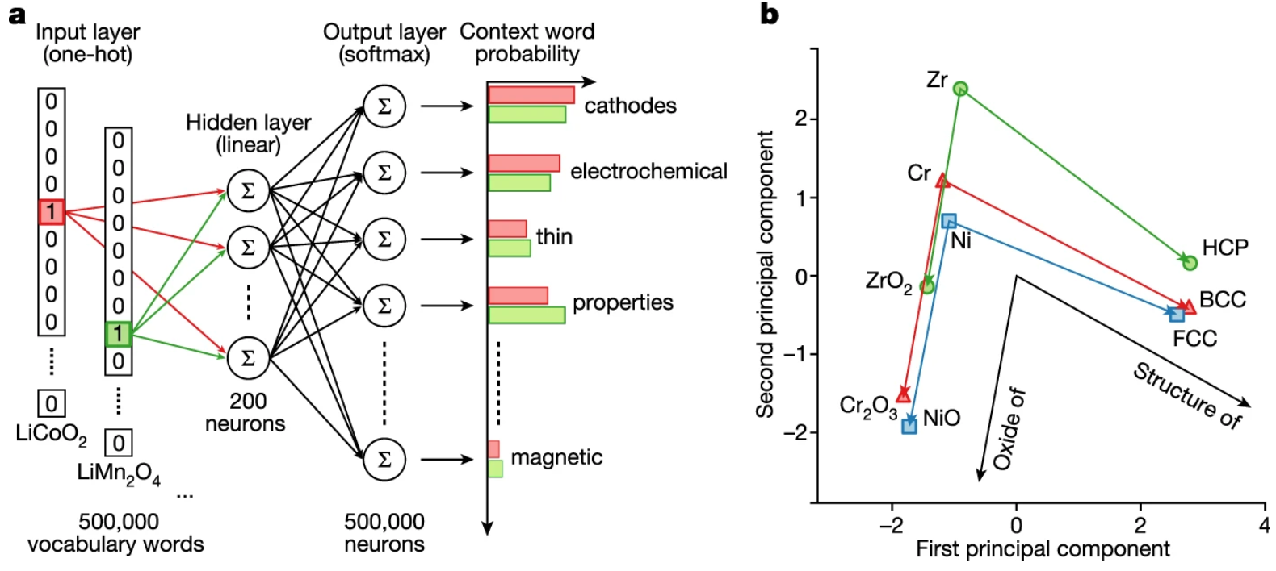
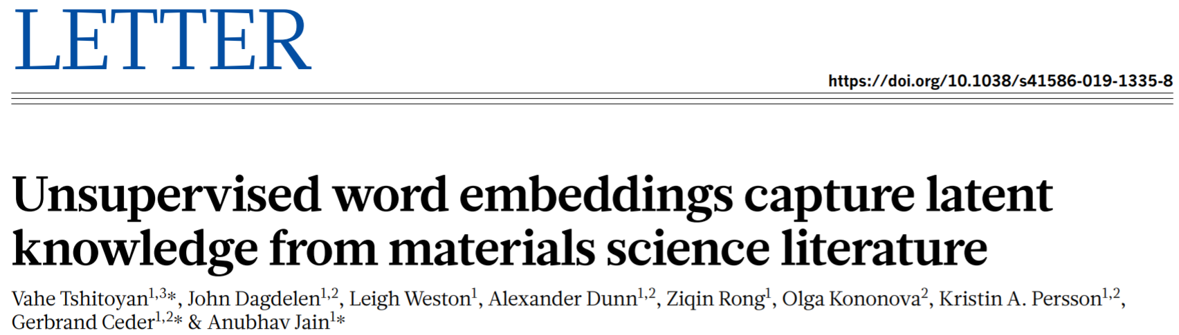
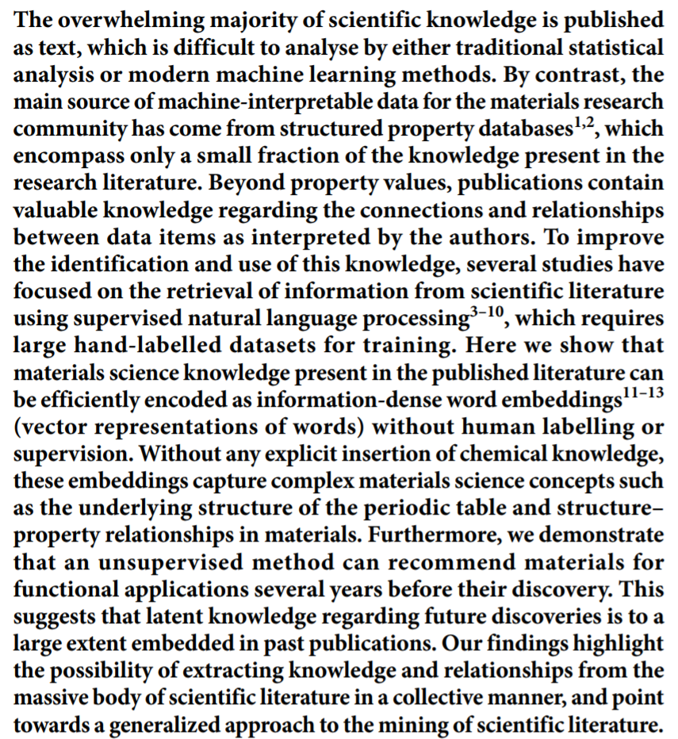
a, Target words ‘LiCoO₂’ and ‘LiMn₂O₄’ are represented as vectors with ones at their corresponding vocabulary indices (for example, 5 and 8 in the schematic) and zeros everywhere else (one-hot encoding). These one-hot encoded vectors are used as inputs for a neural network with a single linear hidden layer (for example, 200 neurons), which is trained to predict all words mentioned within a certain distance (context words) from the given target word. For similar battery cathode materials such as LiCoO₂ and LiMn₂O₄, the context words that occur in the text are mostly the same (for example, ‘cathodes’, ‘electrochemical’, and so on), which leads to similar hidden layer weights after the training is complete. These hidden layer weights are the actual word embeddings. The softmax function is used at the output layer to normalize the probabilities. b, Word embeddings for Zr, Cr and Ni, their principal oxides and crystal symmetries (at standard conditions) projected onto two dimensions using principal component analysis and represented as points in space. The relative positioning of the words encodes materials science relationships, such that there exist consistent vector operations between words that represent concepts such as ‘oxide of’ and ‘structure of’.

Slide 11
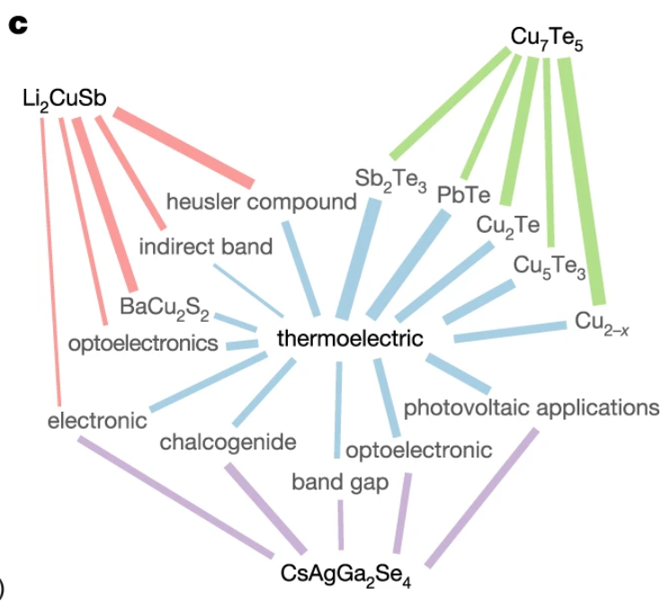
c, A graph showing how the context words of materials predicted to be thermoelectrics connect to the word thermoelectric. The width of the edges between ‘thermoelectric’ and the context words (blue) is proportional to the cosine similarity between the word embeddings of the nodes, whereas the width of the edges between the materials and the context words (red, green and purple) is proportional to the cosine similarity between the word embeddings of context words and the output embedding of the material. The materials are the first (Li₂CuSb), third (CsAgGa₂Se₄) and fourth (Cu₇Te₅) predictions. The context words are top context words according to the sum of the edge weights between the material and the word ‘thermoelectric’. Wider paths are expected to make larger contributions to the predictions. Examination of the context words demonstrates that the algorithm is making predictions on the basis of crystal structure associations, co-mentions with other materials for the same application, associations between different applications, and key phrases that describe the material’s known properties

Slide 12
The Design of Scientific Figures
Data tells a story.
Figures communicate that story to another person.

Slide 13
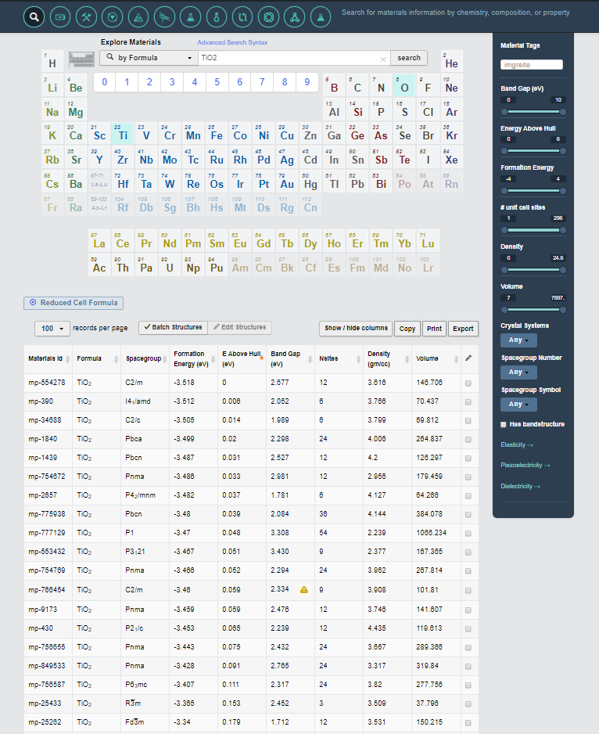
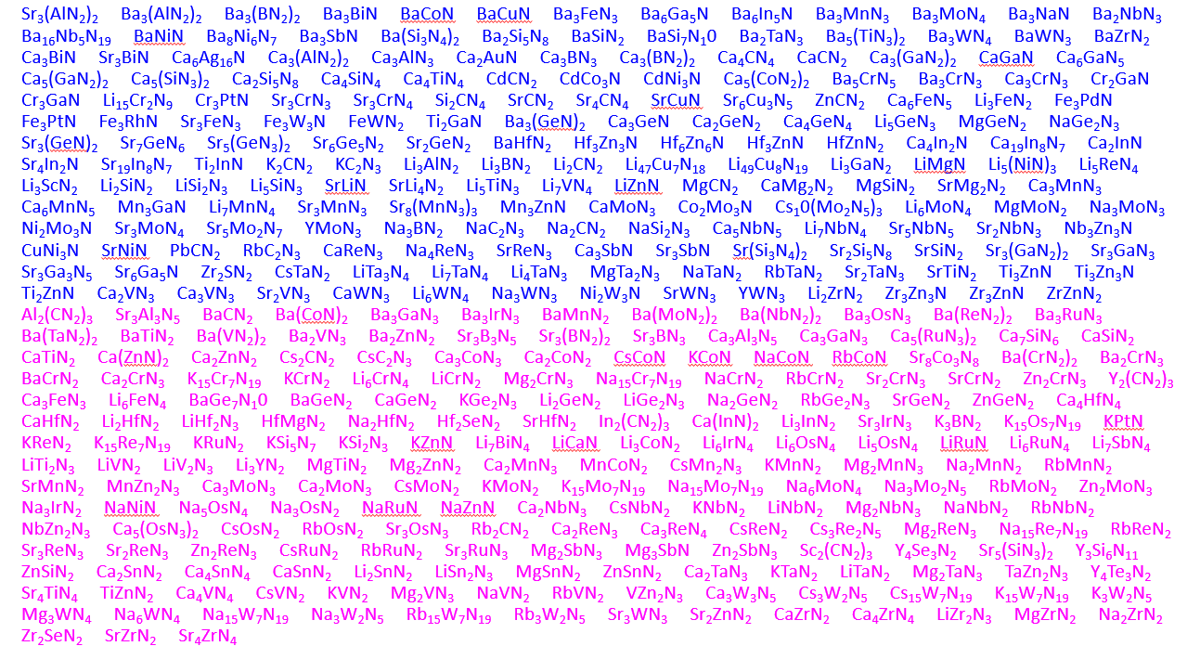
The challenge
From a sea of data …
Finding a story to tell
(Data exploration)
Communicating the story
(Data visualization)

Slide 14
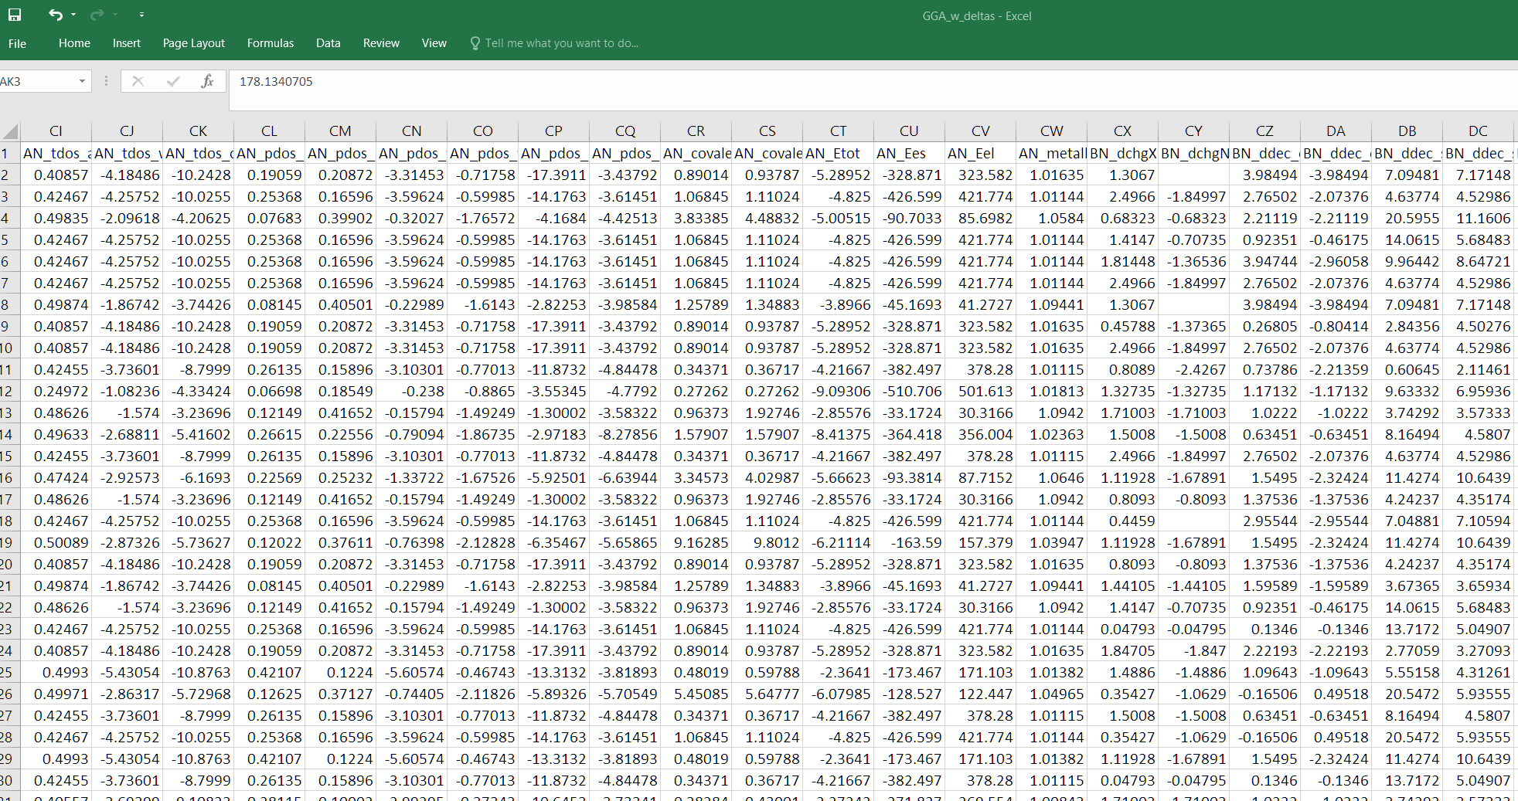
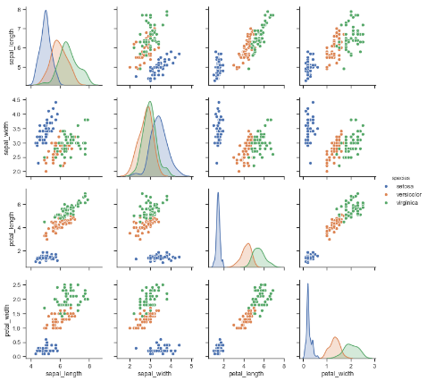
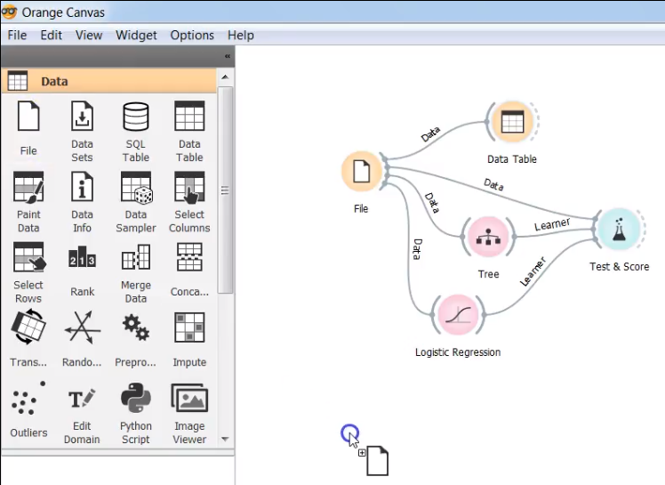

Finding a story to tell: Data exploration
Elemental/Compound Features
Property
Materials Project
Entries
Seaborn (Data Exploration)
Orange (Machine-Learning)
Eureqa (Symbolic Regression)

Slide 15
The challenge
From a sea of data …
Finding a story to tell
(Data exploration)
Communicating the story
(Data visualization)

Slide 16
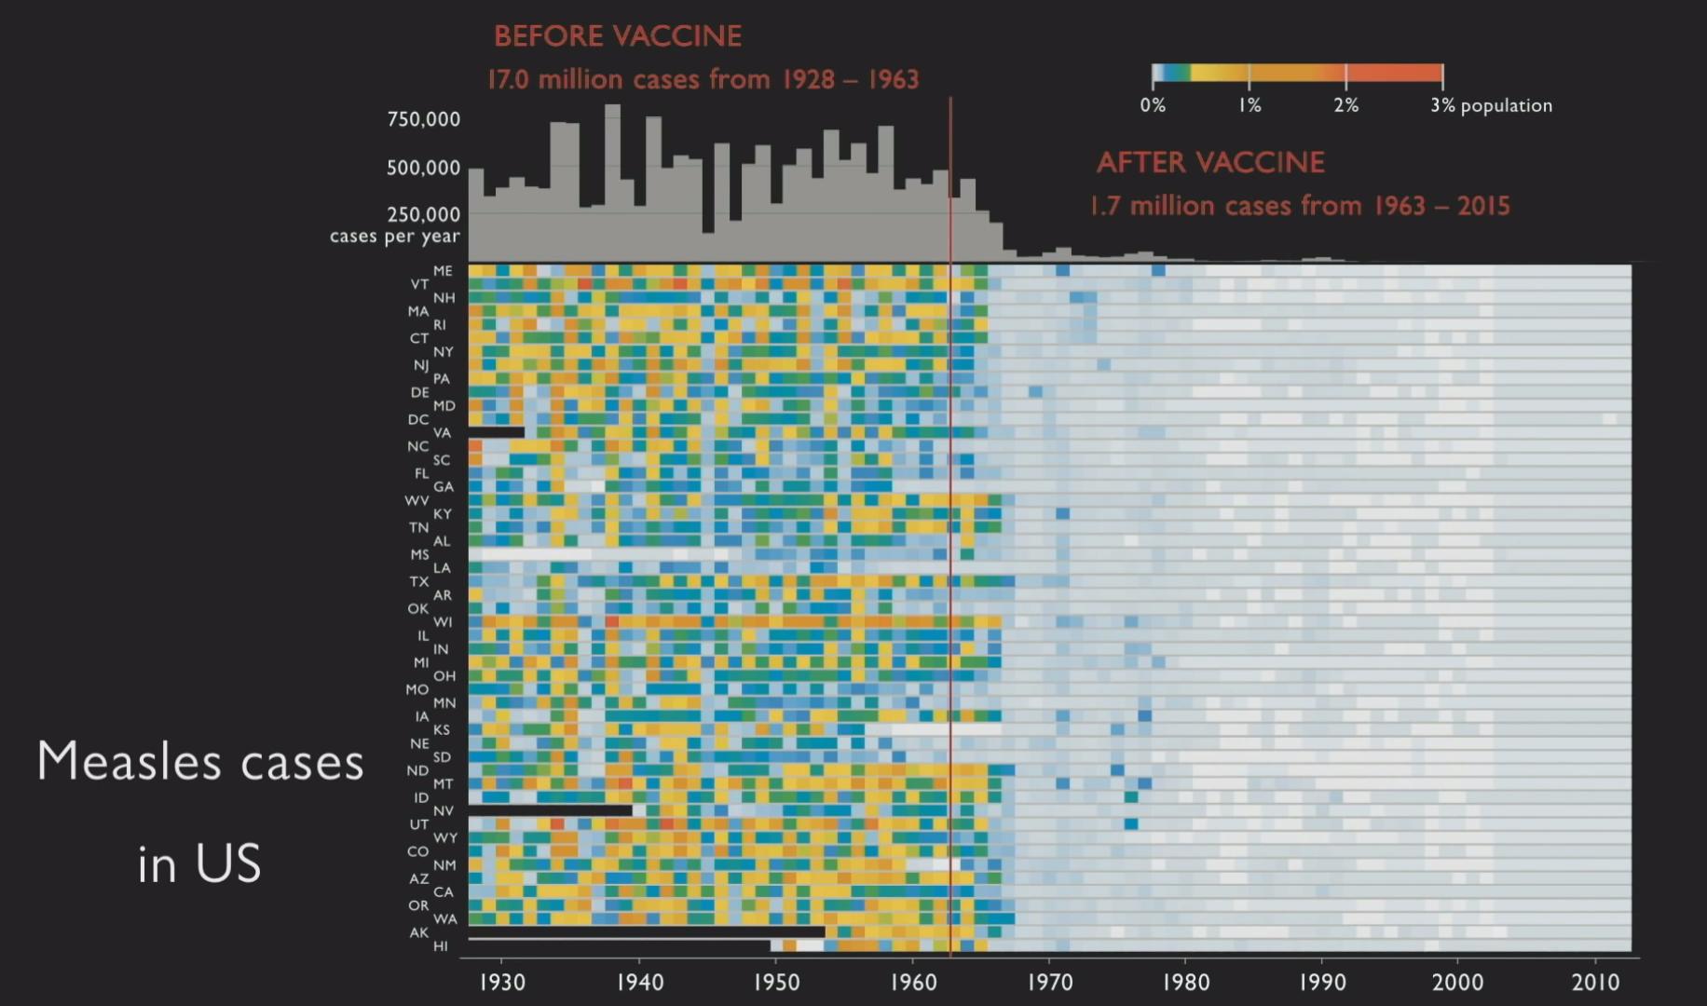

Slide 17
A good figure …
Shows the data
Serves a clear purpose
Tell a story
Give evidence to a story
Encourage the eye to compare difference pieces of data
Reveal the data at several levels of detail, from broad overview to the fine structure
Avoids distorting what the data has to say
Presents many numbers in a small space
Makes large data sets coherent

Slide 18
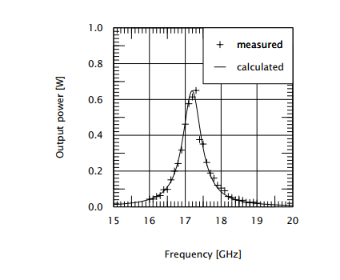
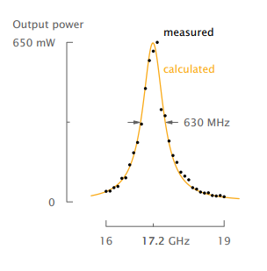
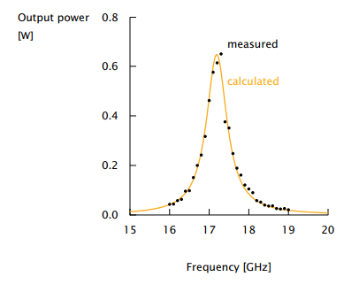
Maximize the Data:Ink Ratio
Original
Removed grid and ticks
Legend moved directly onto graph
Horizontal y-axis label
X-axis shows range, and max value
Y-axis shows range, and max value
Full-width half-max labeled

Slide 19
The easy plots are rarely the most meaningful visualization
Figure galleries only give you an idea on how to get started
You need to design a representation that emphasizes
salient features of your data.

Slide 20
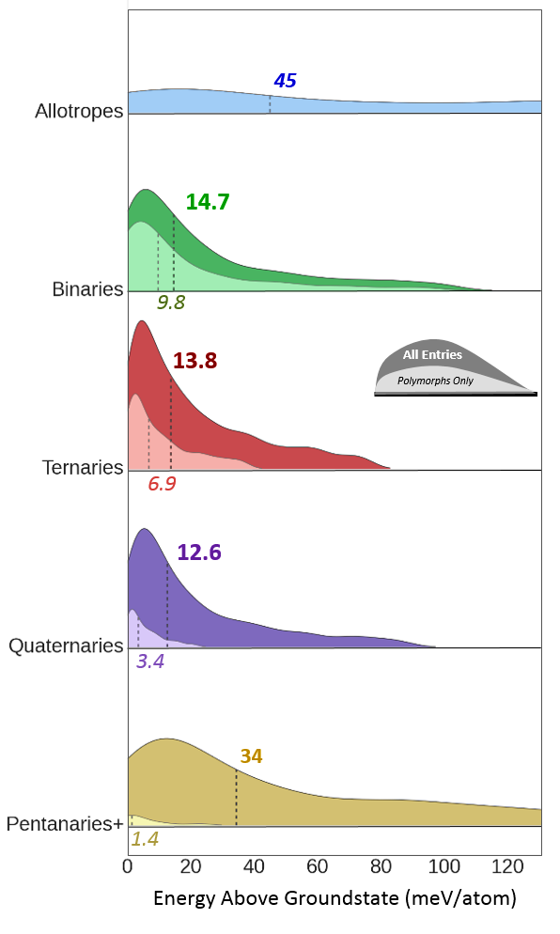
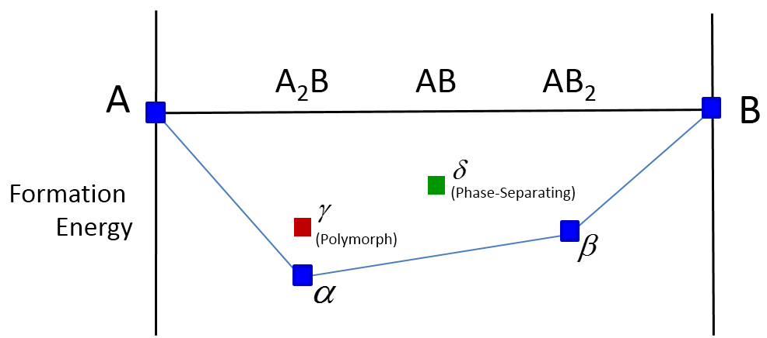
Metastability distributions as a function of number of elements in a compound
Median for all entries
Phase
Separating
Polymorphs Only
Median for polymorphs only
W. Sun et al., The thermodynamic scale of inorganic crystalline metastability” Science Advances (2016)

Slide 21
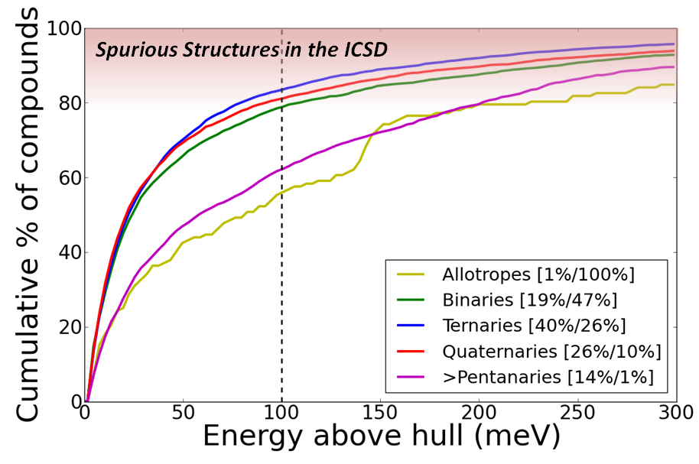
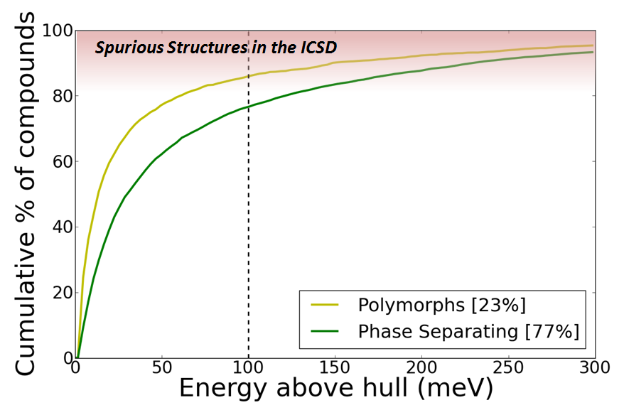
The easy plots are rarely the most meaningful visualization
How does energy above the hull depend on the complexity of the convex hull?
How many components in the hull
Whether the phase is metastable w.r.t a polymorph, or phase-separating

Slide 22
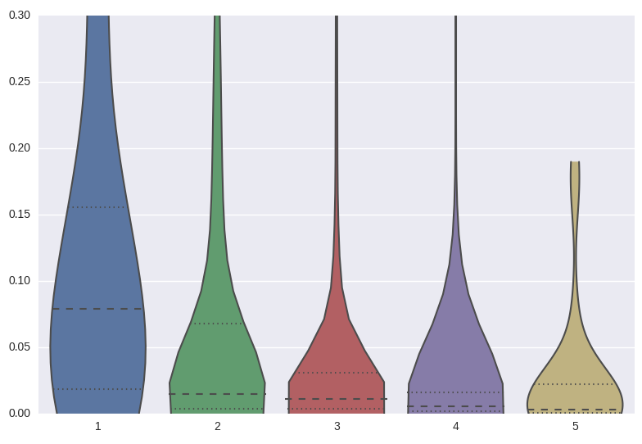
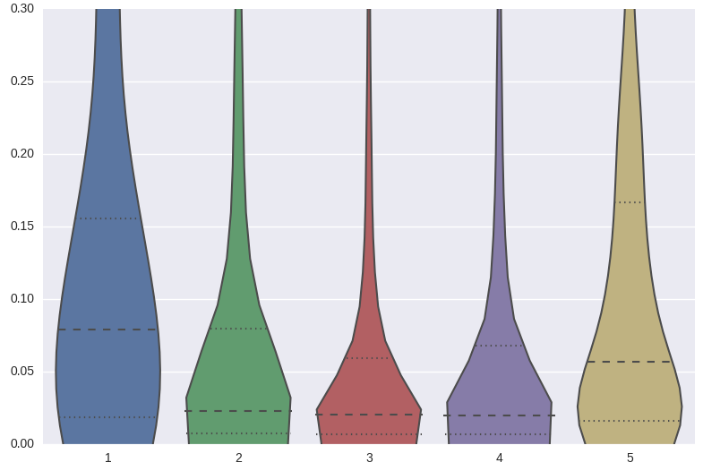
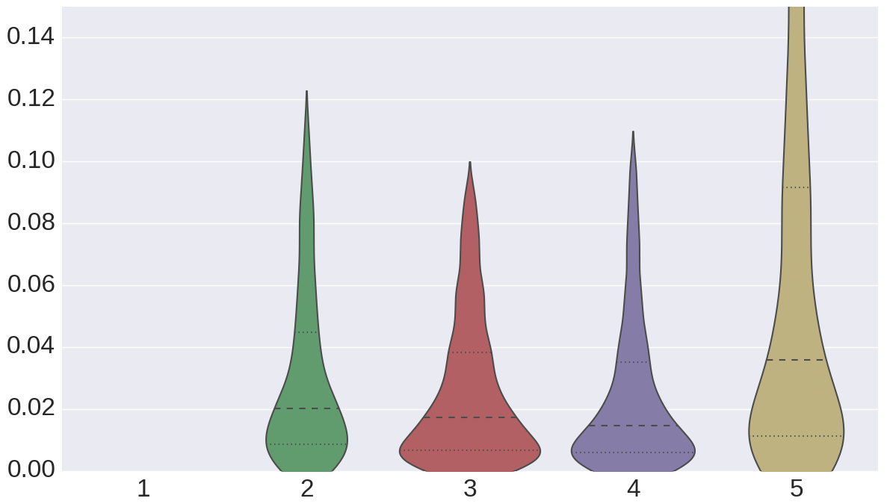
Polymorphs Only
All Compounds
Phase Separating Only

Slide 23
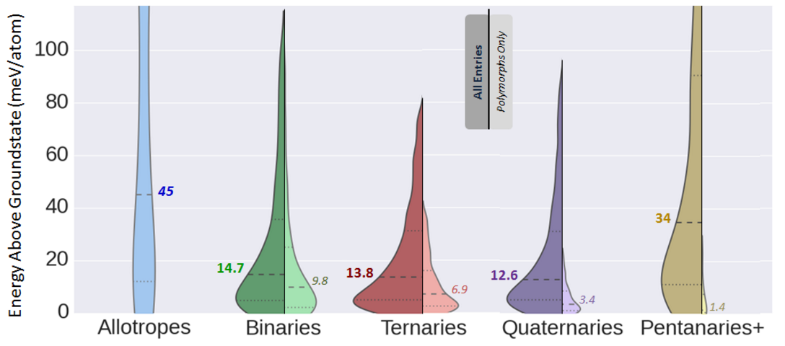
Final Version →
Version 3

Slide 24
Metastability distributions as a function of number of elements in a compound
Walk the listener
through the figure
What are the axes?
What is being plotted?
What features should I pay attention to?
What do these features mean?
Median for all entries
Phase
Separating
Polymorphs Only
Median for polymorphs only
W. Sun et al., The thermodynamic scale of inorganic crystalline metastability” Science Advances (2016)

Slide 25
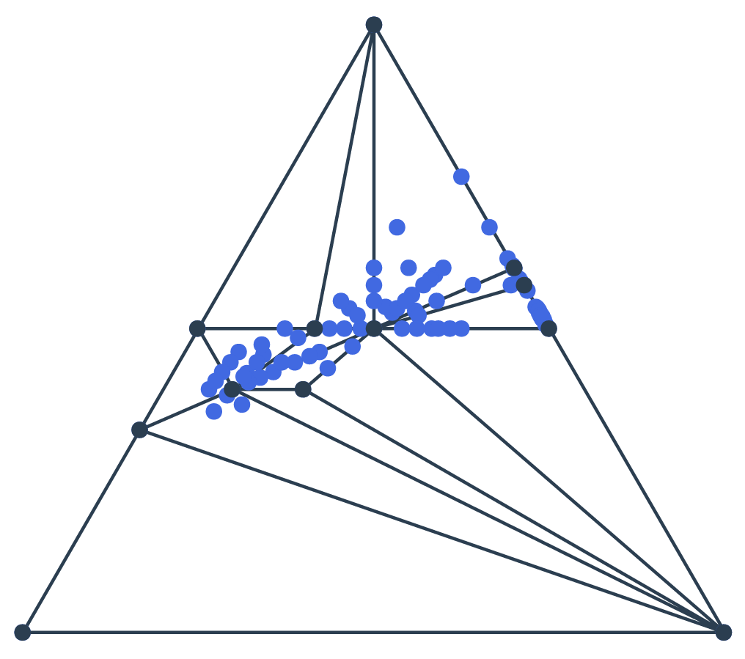
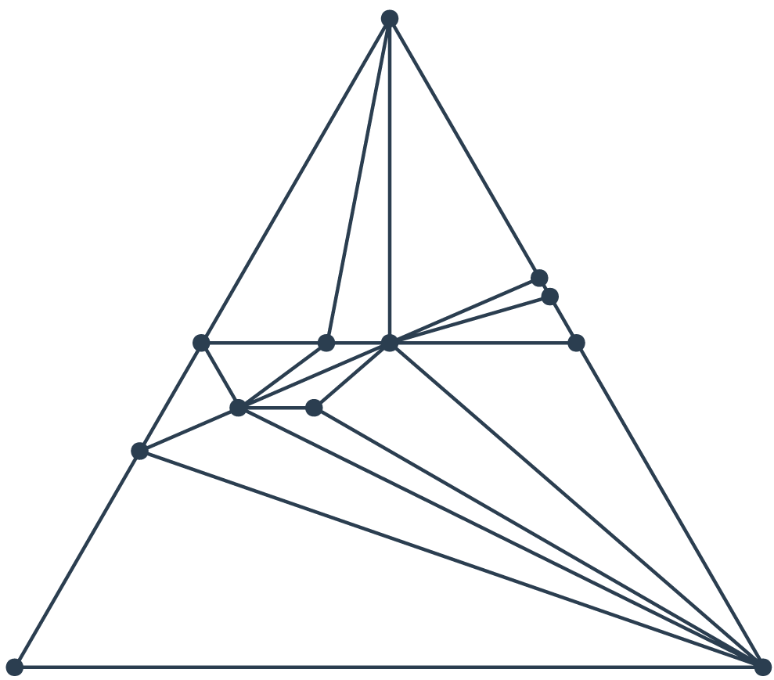
Observations
Walk the listener
through the figure
1. Describe the trend physically
2. Describe the trend
graphically
3. Use supporting figures
to rationalize
your argument.
1. The more elements in a compound, the more likely it is phase-separating instead of polymorphic
O₂
Phase.Sep.
Polymorphs Only
Black – Stable
Blue – Metastable
Li
Fe
Greater chemical space for the existence of stable phases.

Slide 26
Observations
Walk the listener
through the figure
1. Describe the trend physically
2. Describe the trend
graphically
3. Use supporting figures
to rationalize
your argument.
1. The more elements in a compound, the more likely it is phase-separating instead of polymorphic
2. Phase-separating compounds tend to be more metastable than polymorphs.
Phase.Sep.
Polymorphs Only
A A A A A A
B B B B B
A A A A A A
B B B B B
A A A A A A
B B B B B
The process of phase-separation requires long-range diffusion, which can serve as a kinetic barrier
Polymorphs do not have this barrier.

Slide 27
Observations
Walk the listener
through the figure
1. Describe the trend physically
2. Describe the trend
graphically
3. Use supporting figures
to rationalize
your argument.
1. The more elements in a compound, the more likely it is phase-separating instead of polymorphic
2. Phase-separating compounds tend to be more metastable than polymorphs.
Phase.Sep.
Polymorphs Only
3. For polymorphs, the energy scale of metastability decreases with increasing number of elements in a compound.
Allotropes
Binaries
Ternaries
Energy
HCP
BCC
FCC

Slide 28
Questions to ask yourself while designing figures
Before making a figure
What is the story I am trying to tell?
What is the best graph to visualize this figure?
While making a figure
Are there more efficient ways to utilize space?
Can I add visual aids to emphasize trends and relationships?
After making a figure
Can I increase the Data:Ink ratio?
Does my figure tell the story I want to tell?

Slide 29
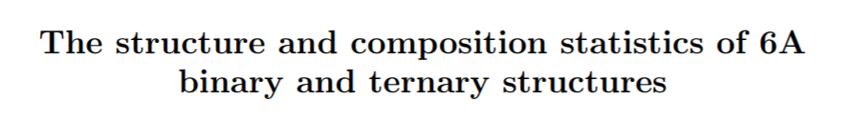
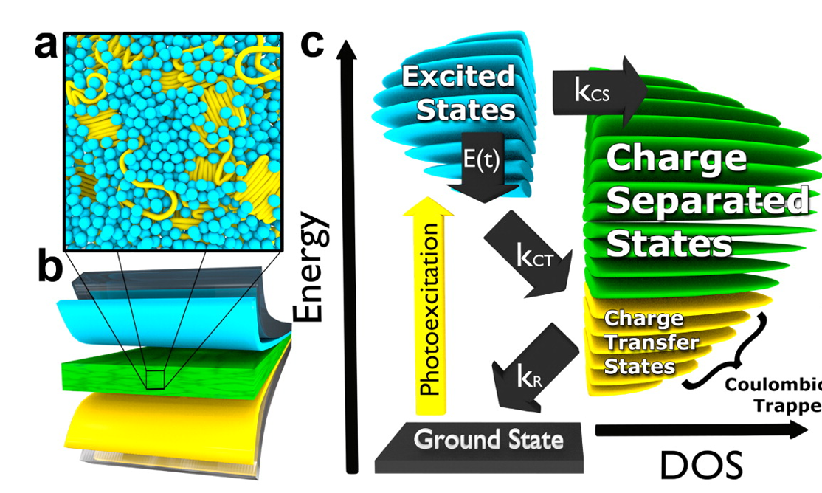
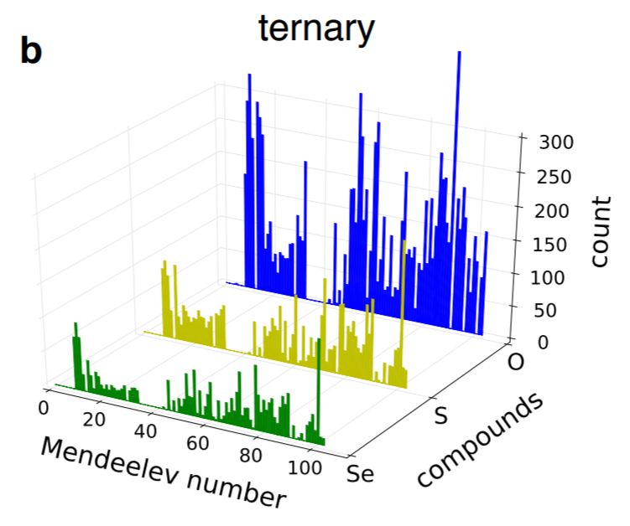
Avoid ‘impressive’ visualizations that communicate little
FIG. 7. Distribution of elements in the compounds

Slide 30
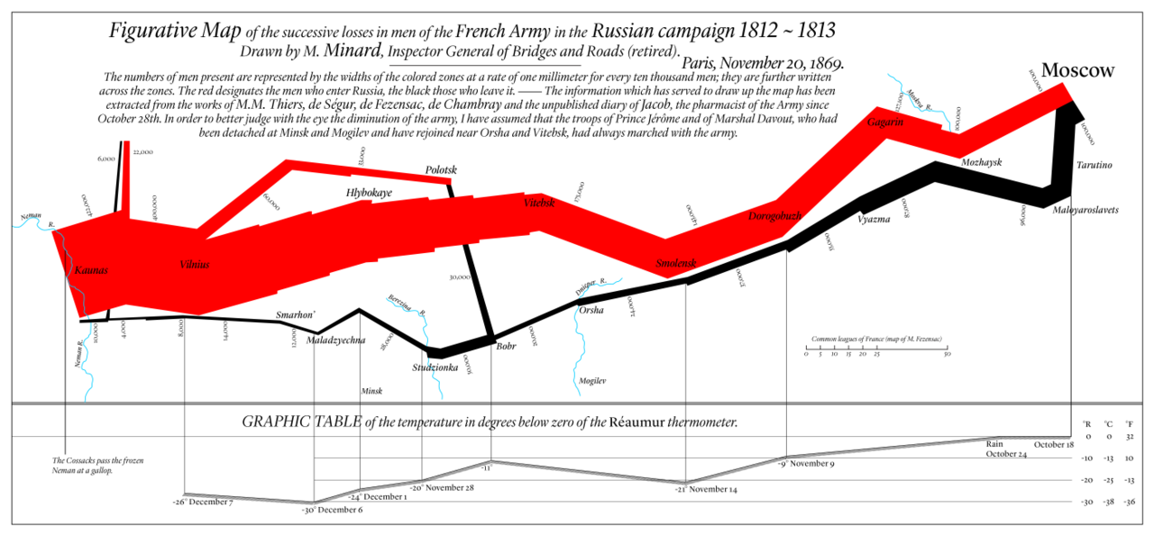
Narrative Figures

Slide 31
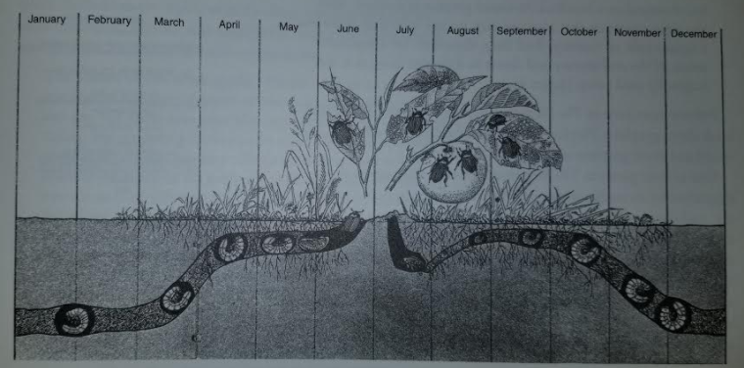
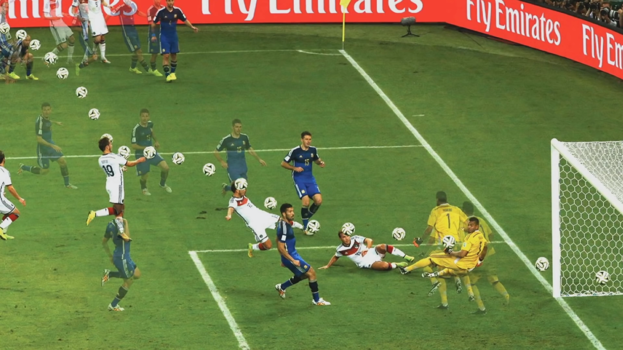
A narrative figure relates a time series to a mechanistic visualization
How might you use narrative figures in your work?

Slide 33

Interactive Figures
Python: Bokeh
Wolfram CDF Player
Distill.pub
https://blog.udacity.com/2015/01/15-data-visualizations-will-blow-mind.html

Slide 34
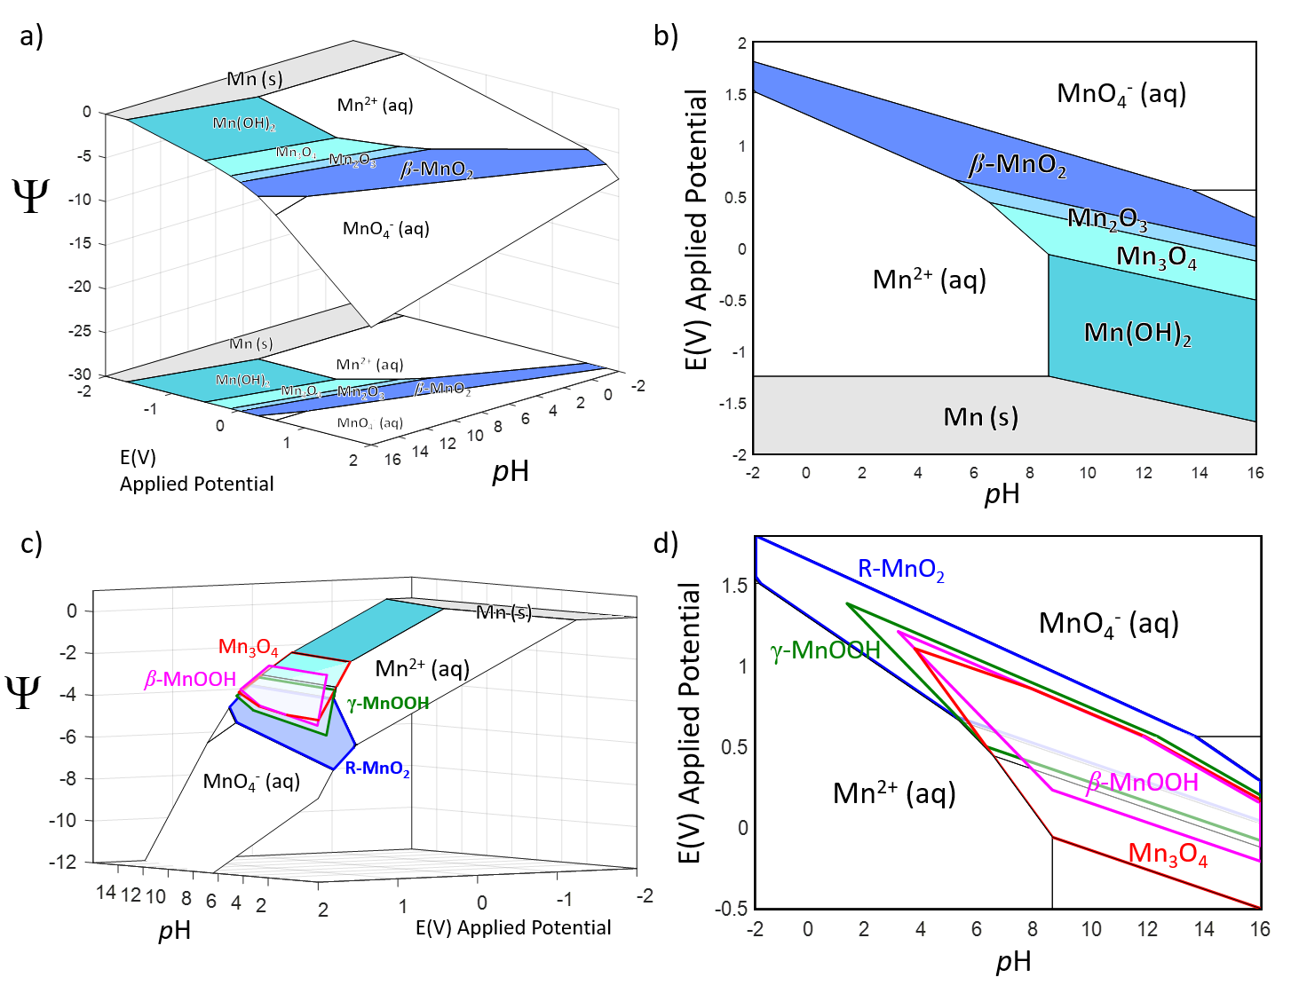
Adding a free-energy axis to Pourbaix Diagrams
Animations!
Pourbaix Thermodynamic Potential

Slide 35
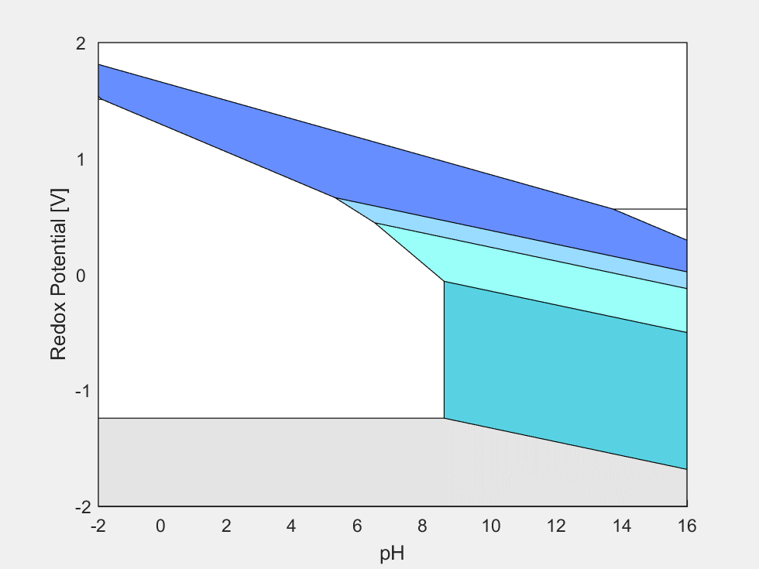
Adding a free-energy axis to Pourbaix Diagrams
Pourbaix Thermodynamic Potential

Slide 36
Adding a free-energy axis to Pourbaix Diagrams
eV/Mn
Pourbaix Thermodynamic Potential

Slide 37
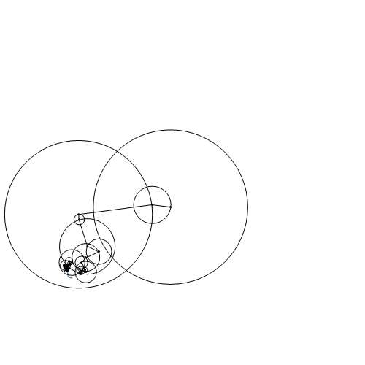
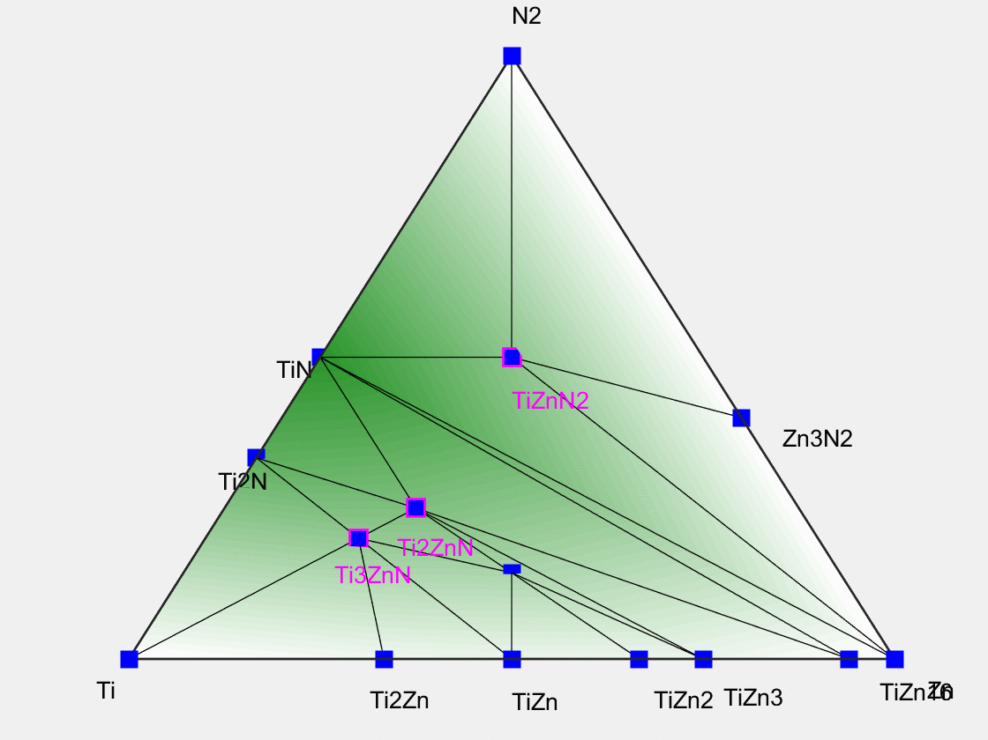
I’ve uploaded a Matlab code to do the rotation animation.
First, save a Figure from Matlab as a .fig file
Then create a 2xN matrix for Azimuth and Elevation (do this manually)
Create a bunch of Matlab figures at different Azimuth/Elevations (rotations)
Save the files into a Gif file.
Can do a similar thing in Python: https://note.nkmk.me/en/python-pillow-gif/

Slide 38
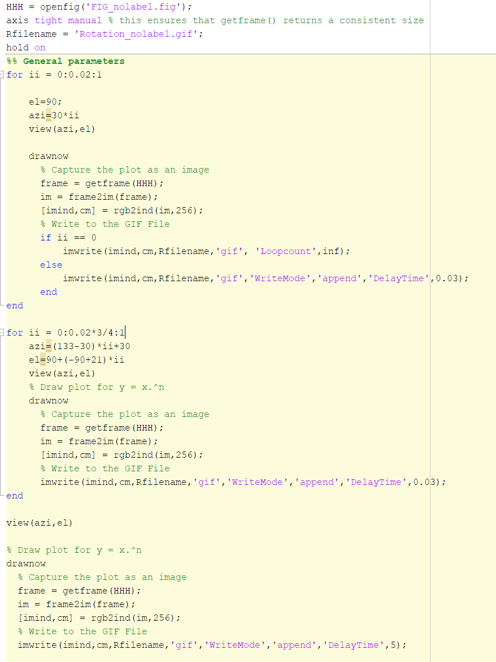

Slide 39
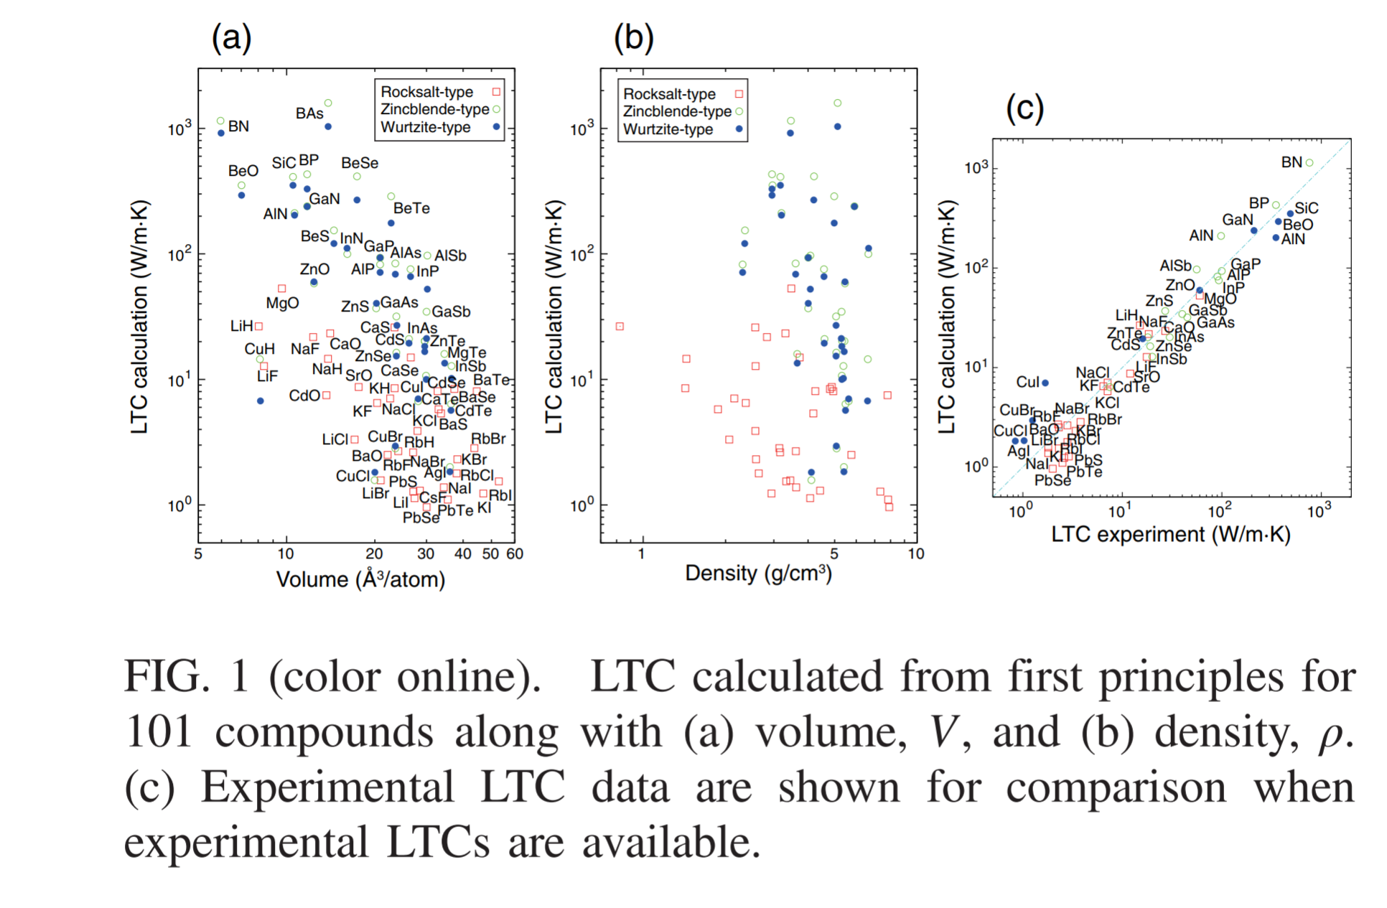
Readable scale: Make your axis/text readable
Physical review letters 115.20 (2015): 205901.

Slide 40
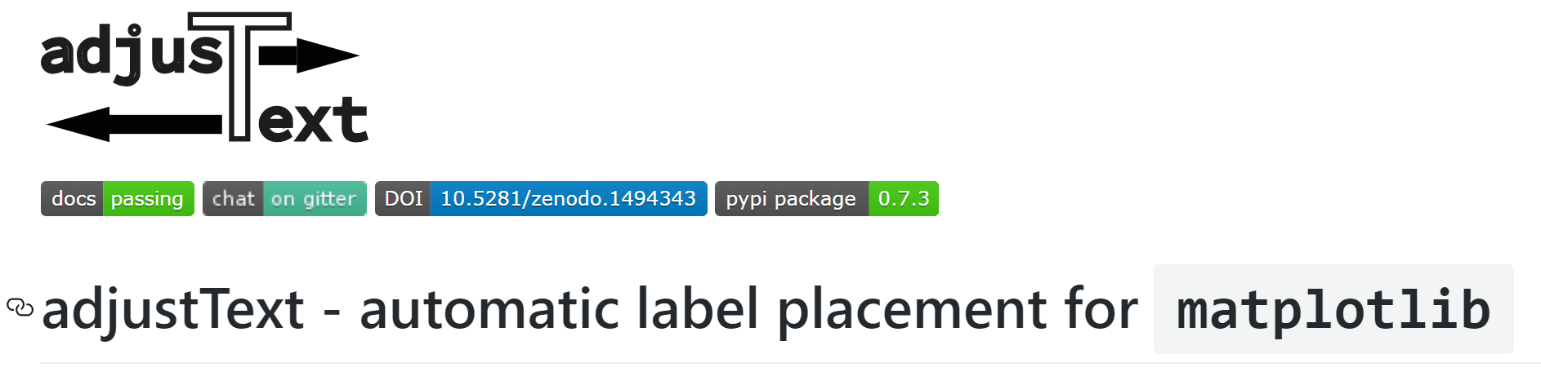
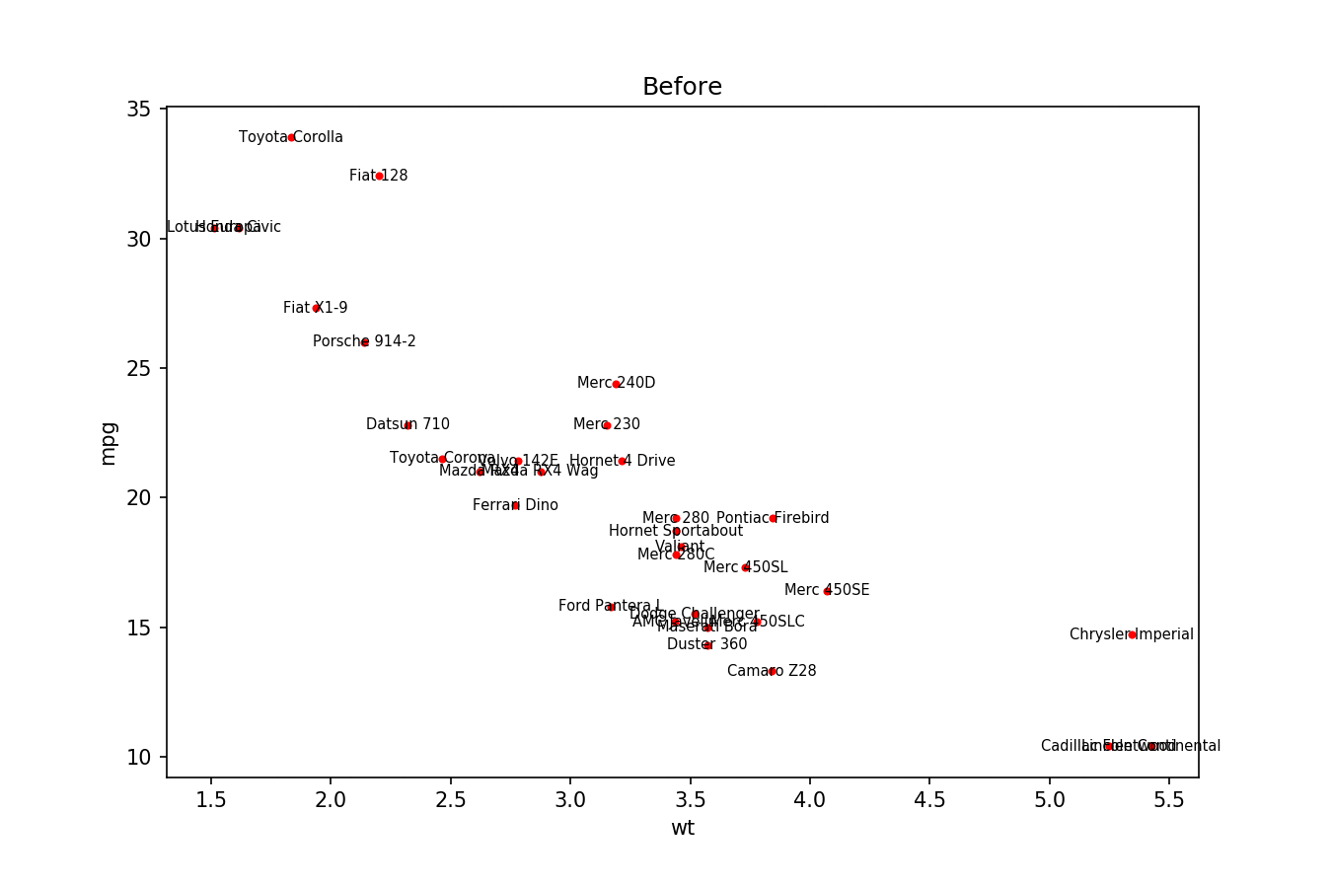
https://github.com/Phlya/adjustText

Slide 41
Presentation: animation-enabled explanation
Notes:
This figure is from Will’s paper. I use this one in my ECS talk, but initially in my practice talk, I just put this figure directly on the screen, which is really rich in information. Gerd suggested me to add an animation, and the final version is something like this.

Slide 42
Presentation: animation-enabled explanation

Slide 43

Readable: A good example
J. Phys. Chem. Lett. 2013, 4,1578– 1581
Notes:
Here is a good one of being readable.

Slide 44

Effective color choice: avoid “chart junk”
PLoS computational biology 10.3 (2014): e1003506.
Notes:
The 2nd element in a figure is color. When it comes to color, we want to be as effective as possible rather than just use rainbow generated by the software automatically. Here are two examples showing the same data of seven series of samples that are equally important. The left figure is the worst design cuz all the curves cover each other and the different colors chosen by the software do not help to distinguish them. The legend box overlaps part of the graphic, too many tick entries on the axis, and not helpful grid, they all make the left figure not effective at all.
However, in the rigut figure, series have been split into seven plots, each of them showing one series, while other series are drawn very lightly behind the main one. Instead of using 7 colors, the use of two colors, a dark one and a light one, makes it very easy to read and compare different series.

Slide 45



Effective color choice: make your figure clean
Energy & Environmental Science (2017)
Kim, Jae chul, et al. Journal of Materials Chemistry A 5.9 (2017): 4596-4606.
Journal of Power Sources 309 (2016): 122-126.
Notes:
In fact, using less color will always make your figure look cleaner. Here it compares some good and bad examples. All of them are showing some in-situ results. The left ones use one color for one scan, which is OK. But the right one is obviously cleaner. And the right figure use different shade or color to indicate whether it’s a two phase reaction or a solid solution, and just put the cycle curve next to the in-situ scans is definitely a more efficient way to use space. And the texts are bold in curves, which made them readable than the slim ones.

Slide 46


Another good example of showing in-situ data
Bianchini, Matteo, et al. Chemistry of Materials 27.8 (2015): 3009-3020.
Notes:
The same idea was used in Matteo’s paper, which is another good example to show in-situ data. The left figure is the cycle curve, which shows the charge process from right to the left. The first part is GITT cycling and the second part is galvanostatic charge described in the caption. He also picked out some interesting points to discuss and mark them clearly in the in-situ XRDs in the right figure. The whole figure is very clear and readable.

Slide 47


Effective color choice: Perceptual ordering colormap
Rainbow Colormaps
– What are they good for?
– Sometimes absolutely nothing!
Notes:
If we want to use color as another dimension, sometimes a rainbow colormap may cause a problem as well. It doesn’t have a natural ordering. And it’s not perceptually linear ordered, in other words equal distances in the scale do not appear equally different color-wise.
This figure represents the same signal, whose frequency increases to the right and intensity increases towards the bottom, using a rainbow colormap and a single colormap
Using a rainbow tend to hide details in the high frequency domain (bottom-right part). While a sequential colormap such as the purple one, it is easier to see details in that domain.

Slide 48

Effective color choice: Perceptual ordering colormap
Rainbow Colormaps
– What are they good for?
– Sometimes absolutely nothing!
Kim, Jae chul, et al. Journal of Materials Chemistry A 5.9 (2017): 4596-4606.
Notes:
If we want to use color as another dimension, sometimes a rainbow colormap may cause a problem as well. It doesn’t have a natural ordering. And it’s not perceptually linear ordered, in other words equal distances in the scale do not appear equally different color-wise.
Here I give a good example using red as a main color in the color map. The whole figure shows in-situ XRD patterns, from the dark red down here to the light color up, the intensity increases. From the figure it shows clearly a two phase reaction region and solution region.

Slide 49



Effective color choice: color combination
Chemistry of Materials 25.14 (2013): 2777-2786.
Lee, Jinhyuk, et al. Energy & Environmental Science 8.11 (2015): 3255-3265.
Blue and orange are contrasting colors and have high visibility. They are usually visible to most color-blind people as well.
Using redundant coding is helpful.
Journal of the American Chemical Society 134.48 (2012): 19619-19627.
Notes:
The last point of color choice is color combination. When we use different color in one figure, we want to make sure they are easy to distinguish. The problem from the left figures is it use very light yellow and light green, which makes it not that easy to tell. The right two figures are two good examples. If we have only two colors in one figure, we suggest to use blye and orange because xxx. And using redundant coding is always a good idea to show curves.

Slide 50



San-serif fonts look cleaner in figures
Ceder Group (Arial)
Ceder Group (Helvetica)
Ceder Group (Calibri)
Ceder Group (Gill Sans)
Ceder Group (Times New Roman)
Good in figure
Bad in figure
Notes:
The last element in a figure is font. When we talk about fonts, they can be basically divided into two types: serif font and san-serif fonts. For example, times is a serif font and helvetica is a san-serif font. Using san-serif fonts in your figure will always make it look cleaner.

Slide 51
Presentation Checklist
Structure | Always start with the big picture. What story do you want to tell? Made the outline.
 | The talk should include introduction, methods, results, discussion (e.g., insight), and conclusion/summary.
 | Plan the timing for each part as you outline the structure.
Introduction | Make sure you motivate the topic. Why should the audience care?
Methods | Equations should be clearly described, with variables or terms individually defined. If there is no time, provide the physical interpretation of each term, and have backup slides with complete information.
 | Consider using schematics. A picture is worth a thousand words!
 | Where approriate, use flowcharts.
 | For simulations, indicate essential information such as the boundary conditions and initial conditions. If the time is limited, put them in backup slides.
Results | Depending on how many results you have, first prioritize by the order of importance and downselect which ones to present. A common mistake is to have too many results for the available time. Choose the result that tells the story you want to tell. If appropriate, some other results can be covered very briefly at the end and refer the audience to a paper.
 | Make sure you emphasize the insights gained -- "So what?" is more important than the results themselves.
Conclusion | Emphasize the takeaways.

Slide 52
Presentation Checklist
Plots | All axis should be noted, labels should be easy to understand (avoid using acronyms), and units should be noted.
 | Fonts should be large enough to read from the back of the room, and all lines should be thick enough.
 | Utilize colors throughout the figure
 | For publications, legends should be noted in the legend box, but for talks it is easier if you put it right on the curve with the corresponding color. Ask yourself if the figure is understandable when looked at for 10 seconds.
References | The references should be noted on the respective page, placed in a manner it is clear what it is for.
 | References are not just for figures from others' work. If something is not your idea, you should have a reference.
 | If you do not include reference for others's work, you may be committing plagiarism. When in doubt, add a reference. It's not worth the risk!
Text | Make sure all texts are legible from the back of the room (of a typical size), including the references.
Other | Include page numbers.
 | The key point/take away should be immediately clear from looking at slide. Consider using the slide title area to make a statement. It is the most-likely read text.
 | Know the key point of each slide. If none, consider removing it.
 | Check spelling one last time...

